Slide 1
The Essence of Statistical Modeling
What is a model
Kinds of models
What does a statistical model look like
How to build a model
Setting adjustable parameters
Building data records
Measures of goodness
Detection rate, false positives, KS, Mean square error, ROC

Slide 2



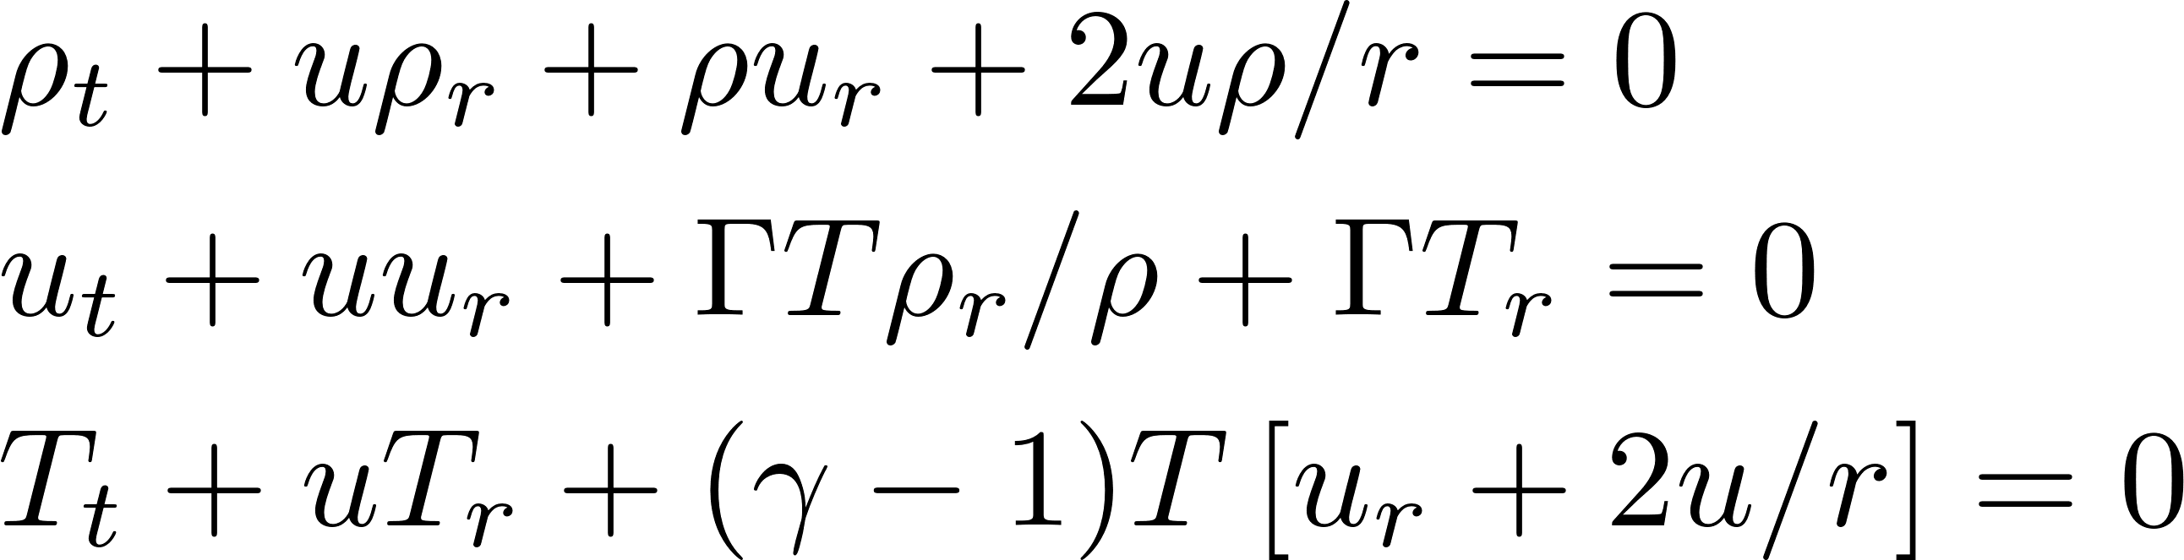


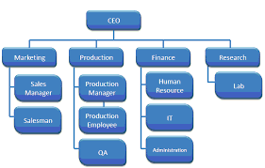
What is a Model?
A model is a representation of reality
Could be first principles equations
Fundamental understanding of system dynamics
Could be simulations, rule systems
Amount of data examples
Could be a statistical model, “learned” from data examples
Notes:
Statistical models:
We don't know a lot about the mechanism behind data, but we do have a lot of examples and learn from them

Slide 3
What is a Statistical Model?
A statistical model is a functional relationship, y = F(x), between a bunch of inputs and an output, where this relationship is approximated from discrete data points that have been collected
Examples:
Will this person pay back a loan? (credit score)
Is this healthcare claim a fraud?
Will John buy this product if I offer it to him?
Where will the stock market be in a month?
A statistical model is built (trained) by “showing” it a data set of past examples

Slide 4
What is a Statistical Model
The model is an explicit mathematical relationship between many inputs and one output
There are free parameters that are adjusted during the model training process according to a set of learning rules
The model will predict something based on some set of inputs
We can write a mathematical expression for this: Y = F(x,a)
Likelihood of fraud
Credit risk
Likelihood of responding
…
Y
Variables x built from the data fields
x₁, x₂, x₃, x₄, …
The F is a mathematical function that maps the inputs to the output
Y is what we are trying to predict:
the model output or target
The a’s are a set of adjustable parameters set during the model training process
The x’s are the inputs or variables in the models
Notes:
What are x, a in Y = F(x,a)?
Think of regression, x are data values, a are the best fit adjusted and fixed

Slide 5
What Does a Model Look Like? – Linear Regression
One of the simplest yet most common models is a linear regression:
Y = a₁ * x₁ + a₂ * x₂ + … + a_{n} * x_{n}
The x’s are variables, the a’s are model parameters (numbers set during the model building process), and Y is the model output (score)
Simple example:
x₁ = # times SSN seen in past 3 months, x₂ = # names at this address
Score = 138 * x₁ + 226 * x₂ This is a Simple Model
These numbers, the model parameters, are set during the model building process

Slide 6
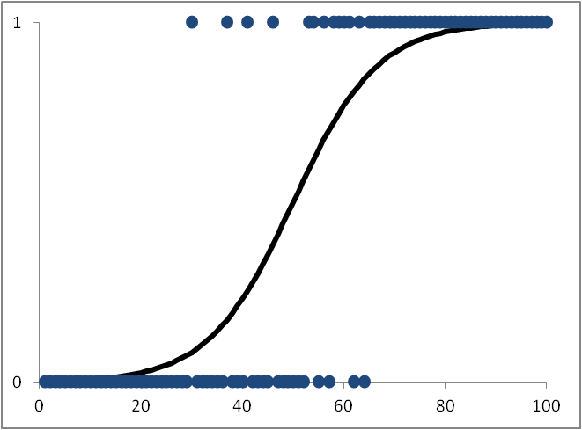
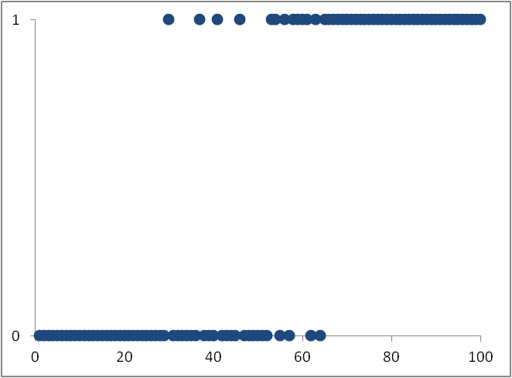
For Binary Output Models, Logistic Regression is Better
Use this for continuous outputs:
Y
fraud/not fraud
Linear Regression
Y
probability of fraud
Fraction of “1”s at that score
Use this for binary outputs:
Logistic Regression
Score
A linear regression is appropriate when the output y has a continuous range.
For classification problems where the output y takes one of two values (e.g., good/bad), the output of the model Y is the probability that it takes a particular value. Since the output Y only ranges from zero to one, a logistic regression is more appropriate. The logit function “squashes” the linear regression function at high and low values, restricting it to between 0 and 1.
Almost all models used in business are either linear or logistic regressions!
Notes:
Logistic regression is basically rescale the domain of regression from [-inf, inf] to [0, 1]
In the world today, most models are either logistic or linear regression
If you got really good variables (from experts), algorithms do not really matter
The essence of ML is that building good variables beats complicated non linear algorithms
Another part is that when dimension is high, fuzzy, everything seems linear (hard to find nonlinearity)

Slide 7
Another Kind of Model – Decision Tree
A decision tree model carves up space into boxes and then assigns a score for each box
THIS IS A SIMPLE MODEL
645
743
The model building process decides where to draw the boxes and what the score in each box should be
4
356
x₂: # names
at address
457
2
5
x₁: # times SSN seen
This decision tree model can be represented as a set of rules:
Could represented by a set of rules or graphically with a tree structure:
Any record
If x₁ < 2, score = 356
If x₁ > 2 and x₂ < 4, score = 457
if 2 < x₁ < 5 and x₂ > 4, score = 645
if x₁ > 5 and x₂ > 4, score = 743
yes
x₁ < 2?
no
Score = 356
x₂ < 4?
yes
no
Score = 457
x₁ < 5?
yes
no
Score = 645
Score = 743
Notes:
Where can I cut the dimension box to achieve my goal the best (in this case to separate output values the best)

Slide 8
Decision Trees Can Be Complex
A real model might be a complex decision tree:
Or it might be a sum of many simple decision trees:
A typical decision tree model carves up lots of boxes in moderate to high dimensional space
x₂
x₁
Score = 1.00 + .99 + .97 + .96 + .94 …
A boosted decision tree model is a sum of weak learners
Notes:
Trees are notorious for overfitting, they are sensitive to noises
With a boosted tree ( a linear combination of several trees) we can compromise the overfitting problem ( industry best practice)
The concept of boosting is the combination of series of weak learners (not necessary trees), in every iteration the weight is proportional to errors and then updates
In my word, there will be many iterations and in each iteration a weak learner is built, (they are all on the same data), and we adjust the weight in proportion of errors
Or random forest, where each tree is built independently (randomly picking data )

Slide 9
There are Many Methods for Statistical Models
Statistics community:
Linear, logistic regressions
PCR, PLS
Factor analysis
ARIMA, GARCH forecasting
Machine learning community
Decision trees
Neural nets/MLP
SVM
Nearest neighbor
Clustering
Generally show all the data at once
Generally linear
Generally learn incrementally, point by point
Generally nonlinear
…
Boosted trees
Random forests
Bayesian networks
Deep learning
Convolutional neural nets
…

Slide 10
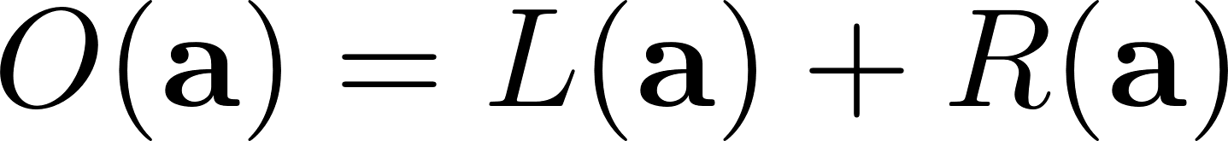
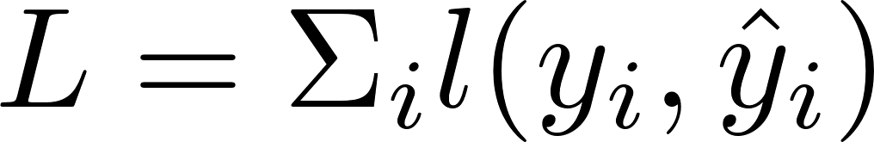
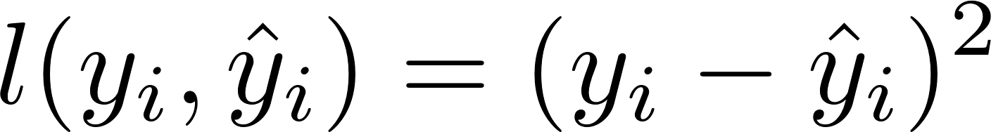
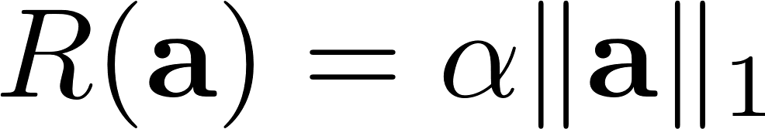
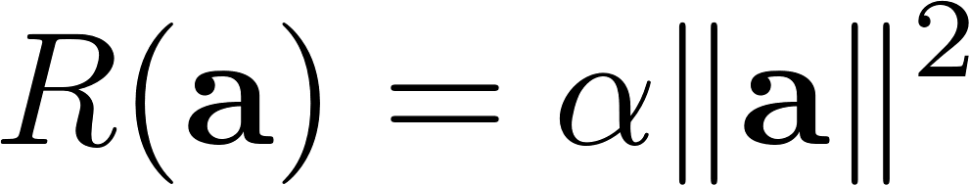
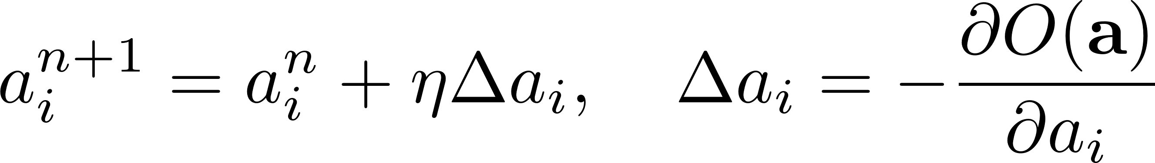
Each ML Method Has An Objective Function and Learning Rules
Objective function is typically a Loss (error) plus Regularization:
adjustable parameters
Loss/error term can be
MSE:
Logistic error:
Error
Regularization
The regularization term minimizes model complexity by minimizing the parameters a
Can use a variety of regularization forms, e.g.
L1 norm (Lasso):
L2 norm:
Each modeling method also has a set of training rules to adjust the parameters a:
learning rate

Slide 11
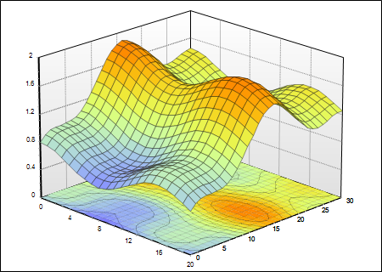
What Does Data Look Like?
Look at max, min, mean, sd’s, distributions, do normalizations
y
x₁ x₂ x₃ … x_{n} y
x₁ x₂ x₃ … x_{n} y
Many
millions
x₁ x₂ x₃ … x_{n} y
x₁ x₂ x₃ … x_{n} y
x₁ x₂ x₃ … x_{n} y
…
x₂
x₁
Many hundreds
Think this way for data preparation, statistical analysis, normalization, standardization…
Think this way for model building process, algorithm design and selection
Building a machine learning model means fitting a best surface through the data points. This is the pretty much all we do when we build a model
The art of model building is finding this “best” surface
Notes:
The dimension of data is n+1 (n x’s and 1 y )
Build the best/ smoothest surface to fit the cloud of data
Best: least error, least complexity (regularization)

Slide 12
How to Build Variables
Need to convert the raw data into normalized numeric variables
Numeric fields: scale carefully, log transforms…
Categorical fields: generally need to convert to a number, typically via risk tables
Build combinations of fields: sums, ratios, min/max’s…
Build expert variables
Talk to domain experts, understand the phenomenon as well as possible
Build special, explicit variables that best relate the raw fields to the output
Examples:
Credit risk scores: open-to-buy, revolve/transact (pay/bal), max # delinquencies in past 12 months…
Tax preparer fraud: % returns with foster children, % returns with schedule C…
Marketing: Income/age, % purchases in a category (e.g. travel, shopping, online…)
General fraud: velocity (# events/time window), # events grouped by entities…

Slide 13
Creating Special Expert Variables
An important part of modeling is the creation of special variables: nontrivial/nonlinear combinations of data that likely relate to the target
Examples are
Ratios (balance/limit, payment/balance,…)
Velocities (# events in various time windows)
Max/mins (max(#connections,10)…)
Logarithms (log(income), log(max(purchase))…)
Much of the art of modeling is in creating special variables. Requires
Good domain knowledge (dynamics of process, human behavior)
Clear understanding of the business objective/target/use
Understanding of the strengths/weaknesses of the modeling techniques
Deep understanding of the data: sources, cleanliness, idiosyncrasies, limitations…

Slide 14
Must be Able to Go Back in Time to Build Models
Slide the Observation Point Across Time Makes models more stable
Use this
To predict this
Model inputs x
Model output y
Time
“Past”
“Future”
Really
today
Pretend
you’re
here
(observation point)
Move the observation point
Use this
To predict this
This:
Model inputs x
Model output y
is a data record for building the model
Scoring
time
The records look like this: (x₁,x₂,x₃,…,x_{n},y)
(x₁,x₂,x₃,…,x_{n},y)
(x1,x₂,x₃,…,x_{n},y)
…
Hundreds of thousands of records for model building
inputs
output

Slide 15
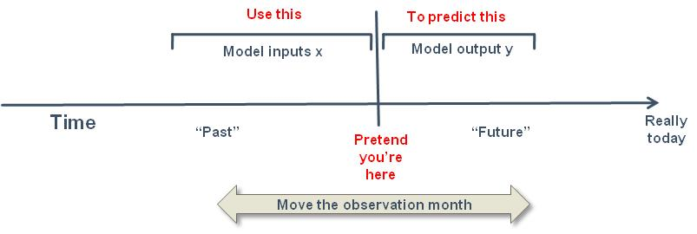
How to Assemble Modeling Data: Inclusions & Exclusions
Pretend you’re sitting at a time in the past
Look in that record’s “past” to collect potential model inputs
Look in that record’s “future” to decide model output (good, bad, loss…)
Slide the observation point across time to get lots of different modeling records that cover lots of time
Exclusions: remove any records that will inappropriately affect the model:
Remove people whom the model won’t be used on (employees, VIPs…)
Remove records that already show the outcome you’re trying to predict (bad, loss, cancel…). Examples to avoid:
Predict future delinquency but record is already delinquent
Predict future inactivity but account has already gone inactive
Predict collectability but phone number has been overwritten with collection agency
Notes:
It’s like saying if someone is dead today, he will be dead in the future

Slide 16
Out of Time Validation Helps Assure Model Robustness
Use this time period for
model training and testing
Use this time period for
Out Of Time validation
Training, Testing
OOT Validation
Really
today
Time
Validation that the model works even in time frames it has never seen
Provides increased confidence that the model will perform when implemented
Notes:
The fundamental assumption: the past will repeat in the future (at least the pattern )
Highly regulated industries tend to not use adaptive models (compliance…)

Slide 17
The Dark Side of Modeling: Overfitting
What if you want to fit a model to this 1-d data:
But when new data comes in that your model hasn’t seen before this fit can be very bad
y
y
x
x
With a sufficiently complex model you can always get a perfect fit
A simpler model likely fits new data better
y
y
x
x
Overly-complex models don’t generalize well – Overfitting
Must balance model complexity with generalization

Slide 18
How to Avoid Overfitting: Training/Testing Data
Divide data into two separate sets: one for training and one for testing
Build the model on the training data, then evaluate it on the testing data
Measure of model fitness
For example, model error
Model error for the
testing data
This represents the REAL model performance
Model error for the
training data
Stop here
Model complexity
( # free parameters, # training iterations…)

Slide 19
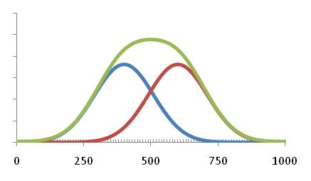
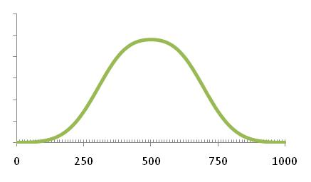
Model Measures of Goodness
Continuous target ($ loss, profit…). Use sum of errors
Each record has an error. Just add up the errors, or the square of the errors
Marketing models typically use lift
Lift of 3 means response is 3 times random
Binary target (good/bad). Use FDR, KS, ROC
KS is a robust measure of how well two distributions are separated (goods vs bads)
# in that bin
goods
bads
Score bin

Slide 20
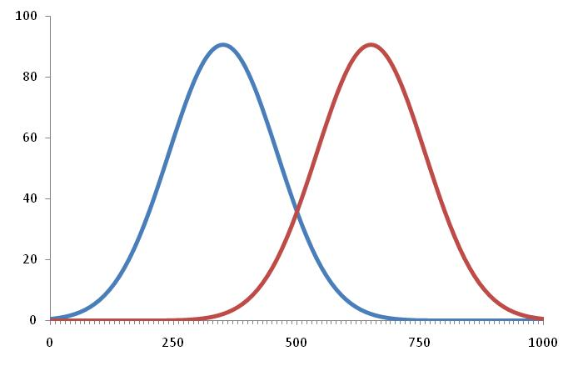
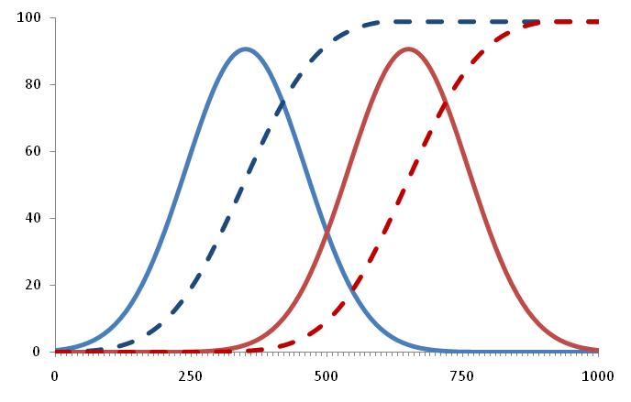
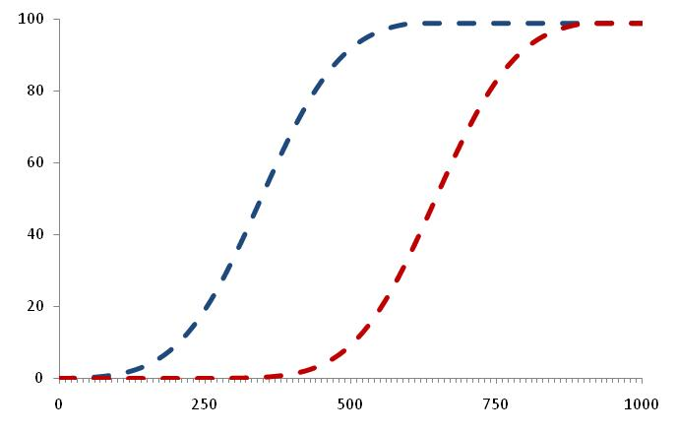
What the Heck is a KS? (Kolmogorov-Smirnov)
We want to measure how well the goods and bads are separated
Plot the goods and bads. Start adding them up (cumulative distribution)
The KS is the maximum of the difference of the cumulatives
cum. goods
cum. goods
cum. bads
cum. bads
goods
bads
KS = 74
Notes:
KS = max S[Pgood - Pbad]ds

Slide 21
True Positives/False Positives (or Negatives)
Build a model, select a cutpoint (cutoff)
The records correctly classified are true positives/negatives
The records incorrectly classified are false positives/negatives
goods
bads
We want high trues, low falses
So another measure of goodness is the relationship of the trues to the falses
Populations
true negatives
true positives
Score cutoff
Good
false negatives
false positives
Bad
Fraud score

Slide 22
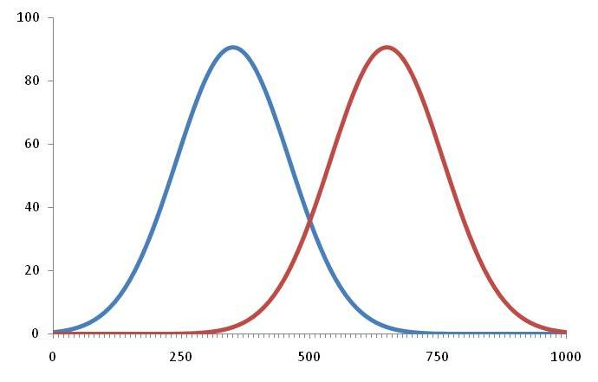
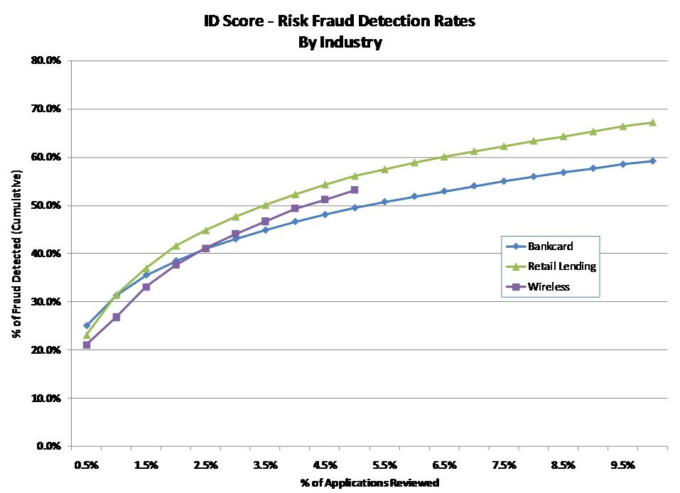
Fraud Detection Rate
For fraud problems we usually measure by Fraud Detection Rate (FDR)
Fraud Detection Rate is very common in business applications. It’s less sensitive to the fraud rate than the False Positive measure of goodness.
Fraud Detection Rate = % fraud found at a cutoff
Can detect 45% of fraud by examining 3% population
goods
bads
Examine from this end

Slide 23
Other Measures of Goodness
Predicted
Start with the confusion matrix:
Accuracy = (TP + TN) / total
Misclassification = (FP + FN) / total
False positive rate = FP / (FP + TN)
False positive ratio = FP / TP
True positive rate (Sensitivity or Recall) = TP / (TP + FN)
True negative rate (Specificity) = TN / (TN + FP)
Precision = TP / (TP + FP)
Type 1 error
Actual
Type 2 error

Slide 24
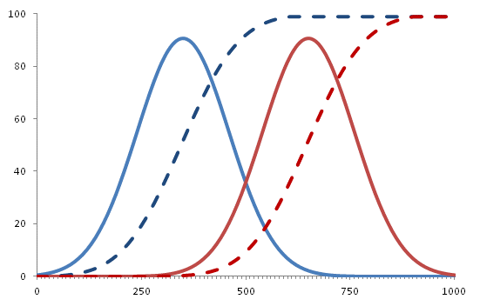
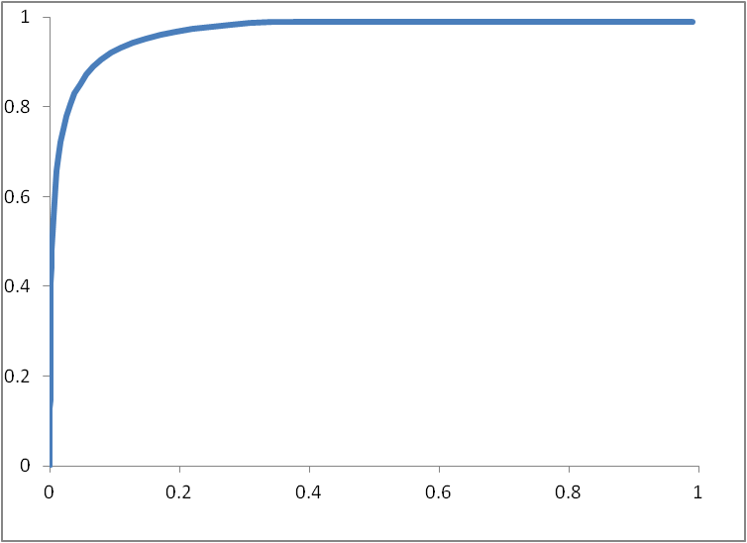
ROC/AUC Goodness Measures
cum. goods
goods
cum. bads
ROC – Receiver Operating Characteristic
ROC is the plot of cum. goods by cum. bads
AUC – Area Under (ROC) Curve
bads
ROC is this curve
KS = 74
Cumulative goods
AUC is this area
This line is for a random model
Cumulative bads

Slide 25
How To Choose Which ML Method to Use
Do you have labeled data? supervised vs. unsupervised
Nature of output to be predicted – categorical, binary, continuous
Dimensionality, noise, nature of raw data/features/variables
Try several methods
Start simple (linear/logistic regression), increase complexity
Always strive to minimize dimensionality. In high dimensions:
All points become outliers (points become closer to outside boundaries than center)
Everything looks linear (# data points required to see nonlinearity increases exponentially)
Notes:
When high dimension
All points become outliers :
Everything becomes linear : when dimensions goes up , it takes exponentially more data to find nonlinearity structure

Slide 26
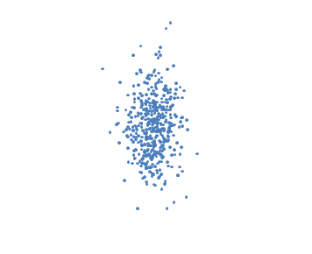
What To Do When You Don’t Have Tags?
How can you build a model to predict something when you don’t have examples of it? In this situation you can build an unsupervised model
Unsupervised modeling examines how the data points are distributed in the input space only (there is no output/label)
You simply look at how the data points scatter. Can you find clusters? Can you see outliers? (the 2 things to find in unsupervised learning)
Clusters: groups of people or events that are similar in nature
Outliers: unusual, anomalous events – potential frauds
Can work well for fraud models where you’re looking for anomalies
Hardest part is figuring out what variables (dimensions) to examine
# address links
Anomalies/outliers
People/events with unusual behavior
Possible frauds
# apps in last 3 months

Slide 27
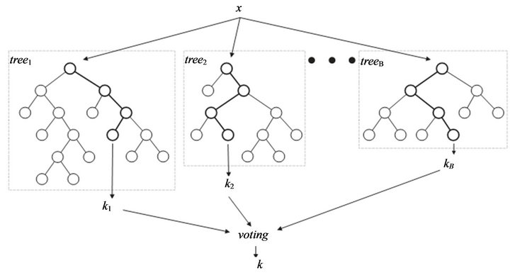
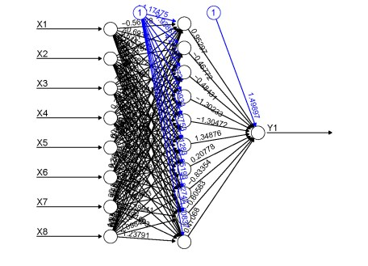
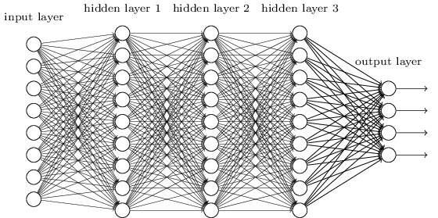
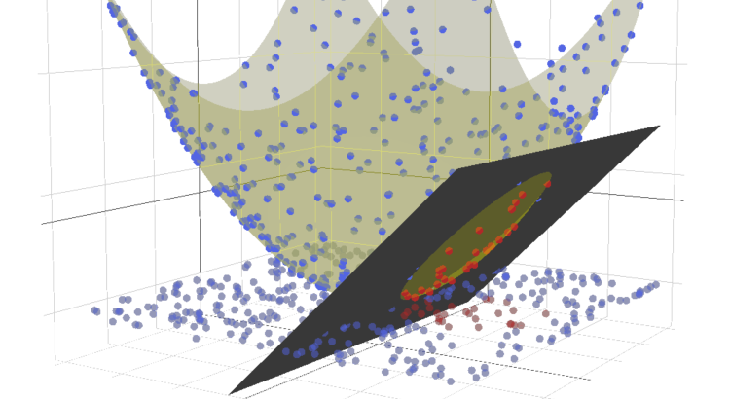
Summary
A statistical model is a functional relationship Y=F(x) found using data
Modeling process:
Prepare data: clean data, build expert variables, encode categoricals, scale, deal with missing values, feature selection
Build models: training/testing to avoid overfitting, measures of goodness
There are a lot of nonlinear modeling methods. Understand them before you use them.
x2
x1
…
Always seek simplicity
Minimize dimensionality via feature selection. Data is always sparse in high dimensions
Minimize complexity. Start simple

